Slide 1
Studying Viruses
Goals—Diagnosis, Cures, Vaccines
Methods
Cell Culture/Host/Transfection
Microscopy
Proteins--Antibodies/ELISA/protein-protein interactions
Nucleic Acids—PCR/RT-PCR/Sequencing/Molecular Biology

Slide 2
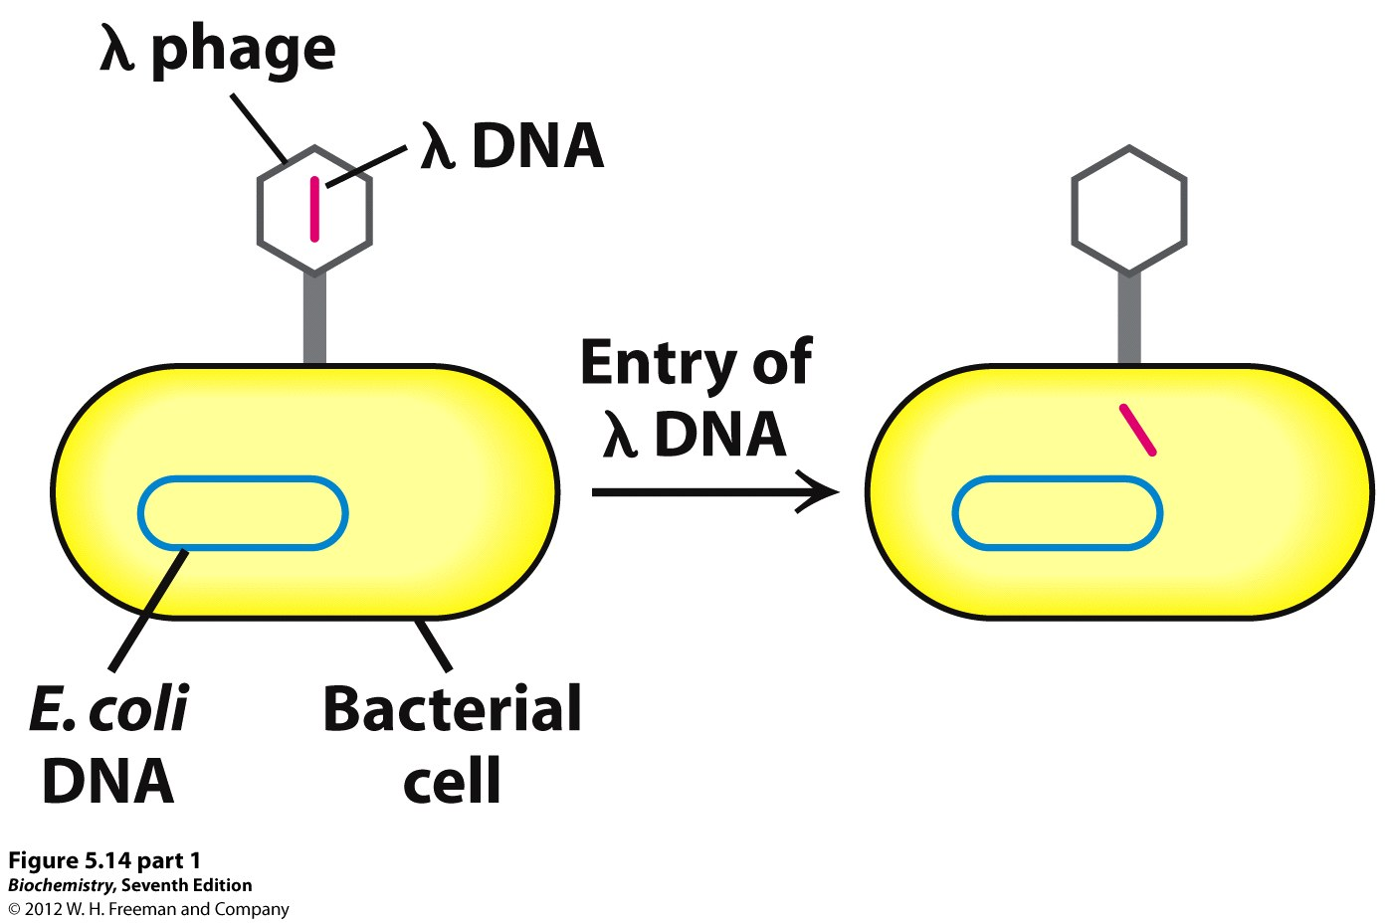
Viruses can be tool for introducing foreign DNA

Slide 3
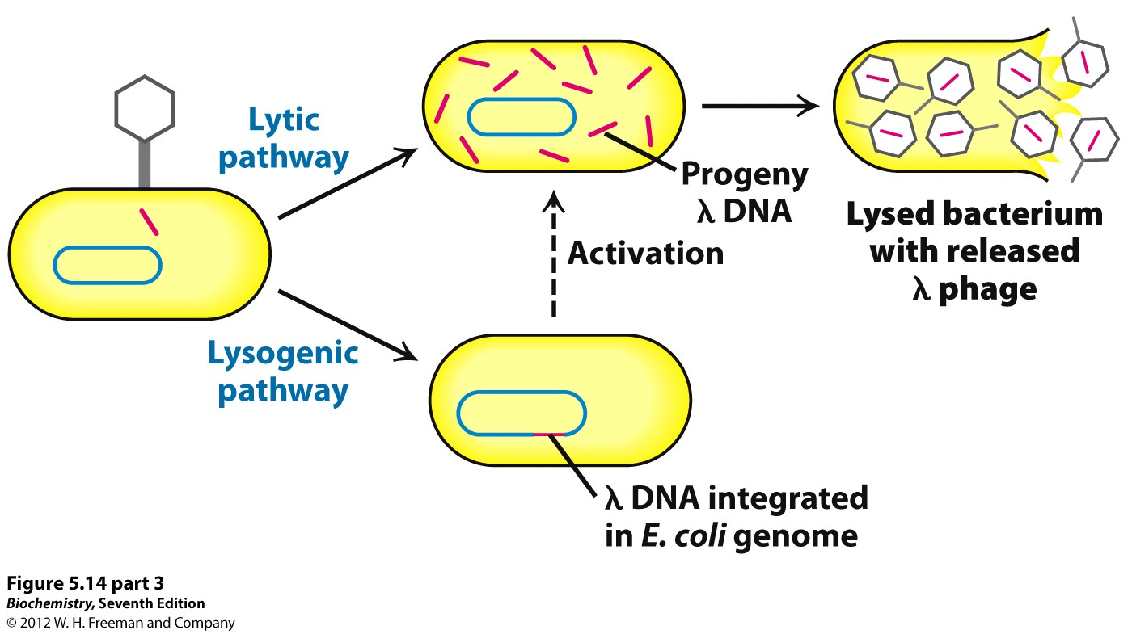

Slide 4
Host-Virus Interactions
Viral Entry
Viral Compromise of Host Defenses
  Viral use of Host Proteins
Viral Exit

Slide 5
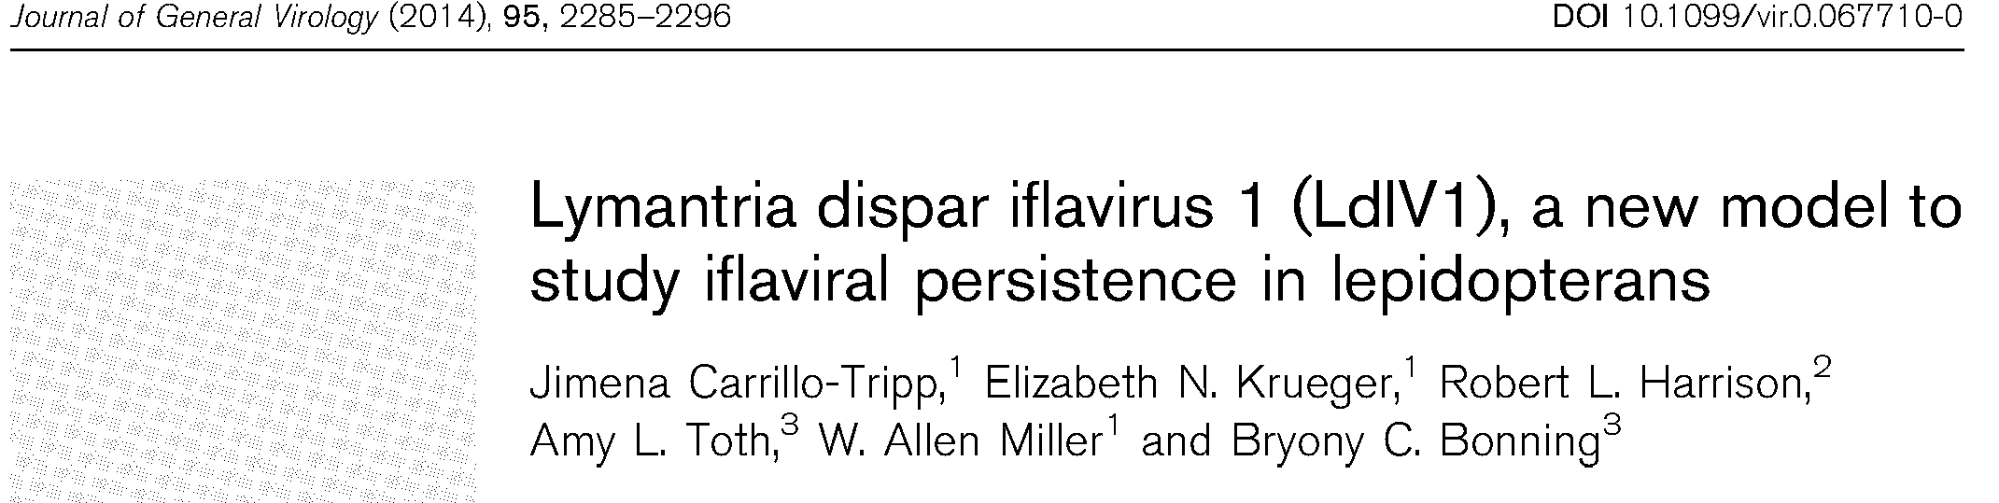
Discovery of a new virus in gypsy moths

Slide 6
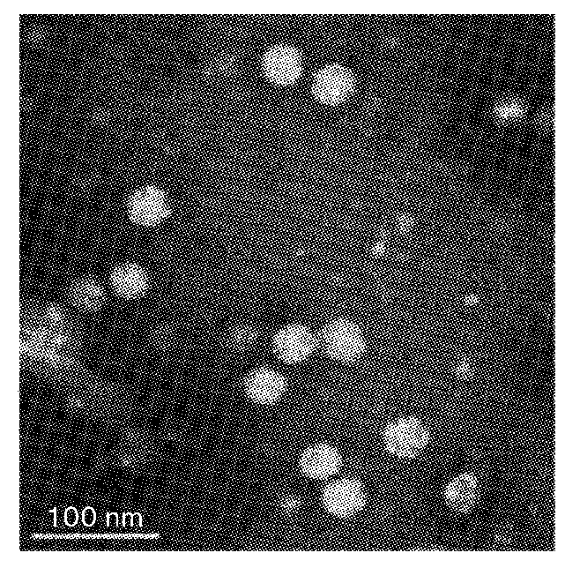
Microscopy
Virus Isolation
Cell lysis by Freeze Thaw
Centrifuge and filter out debris
Ultracentrifuge sucrose (density)
Stain with Ur-acetate
Transmission Electron Microscopy (TEM)

Slide 7
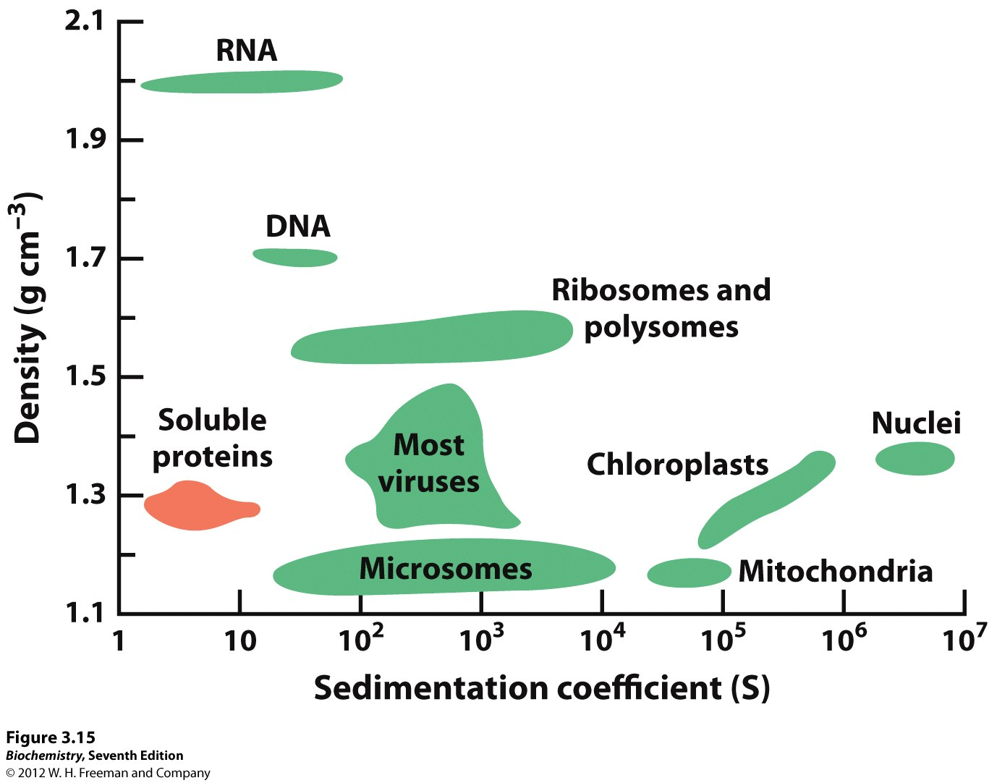

Slide 8
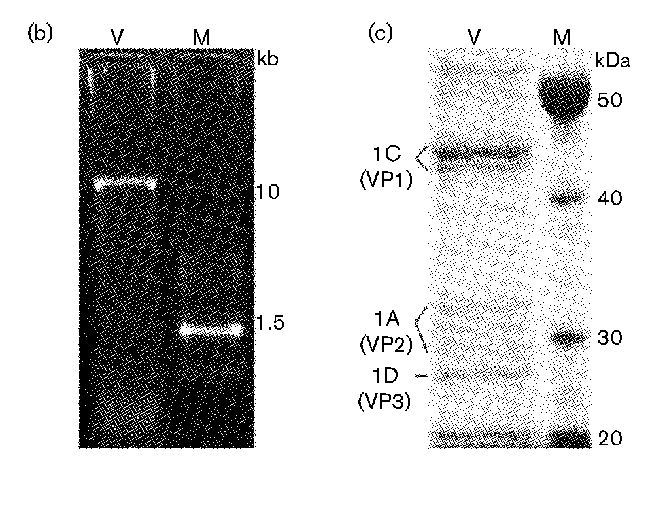
Viral particles contain RNA (10,000 nts)—agarose gel
And several proteins—SDS gel

Slide 9
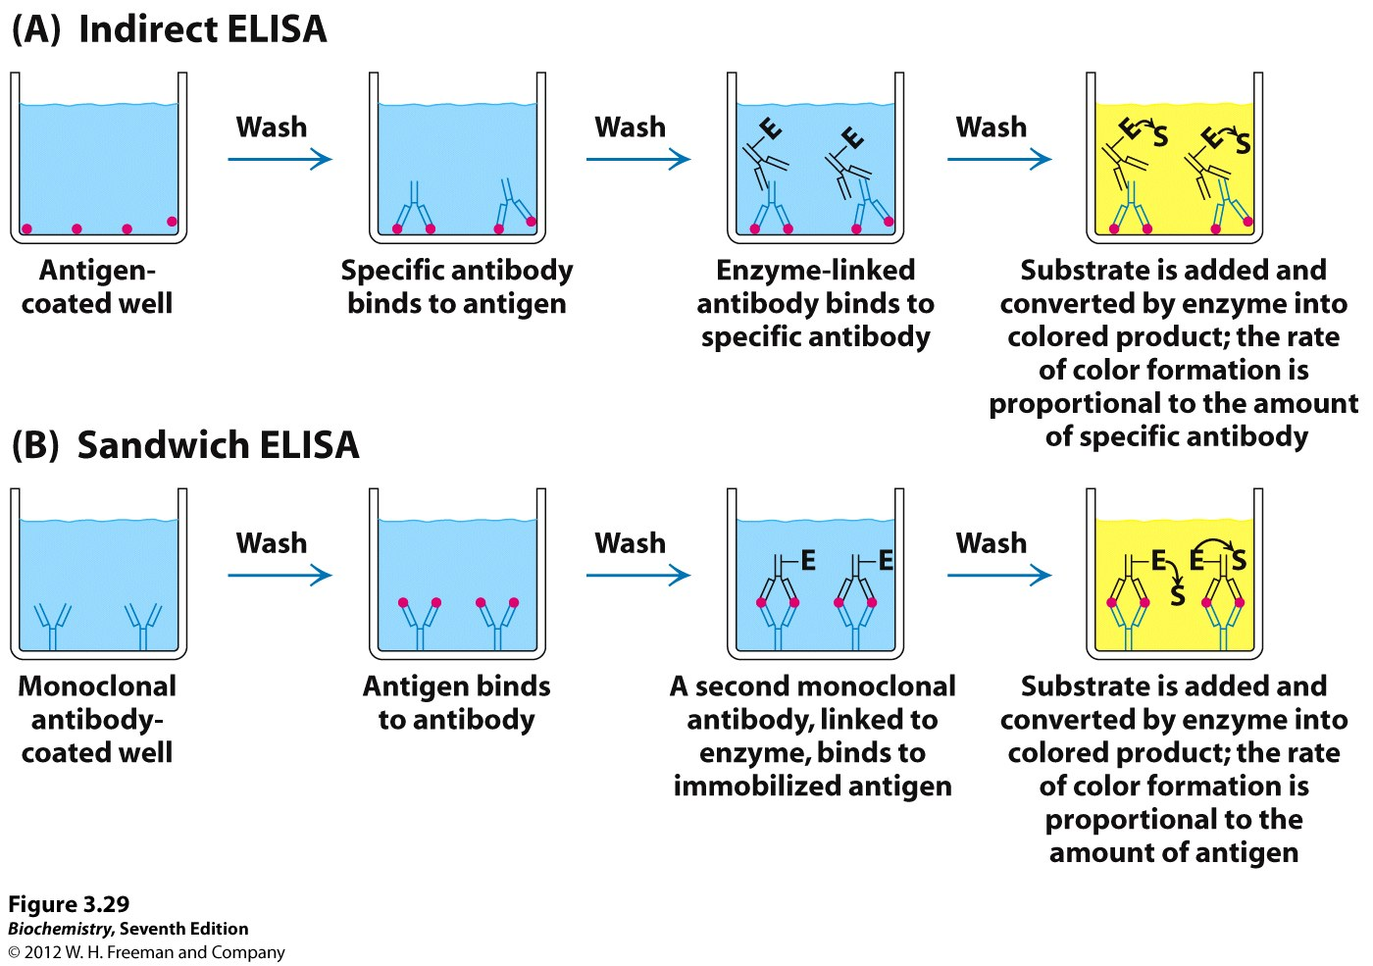
Diagnosis—if patient is infected,
their blood contains antibodies to virus

Slide 10
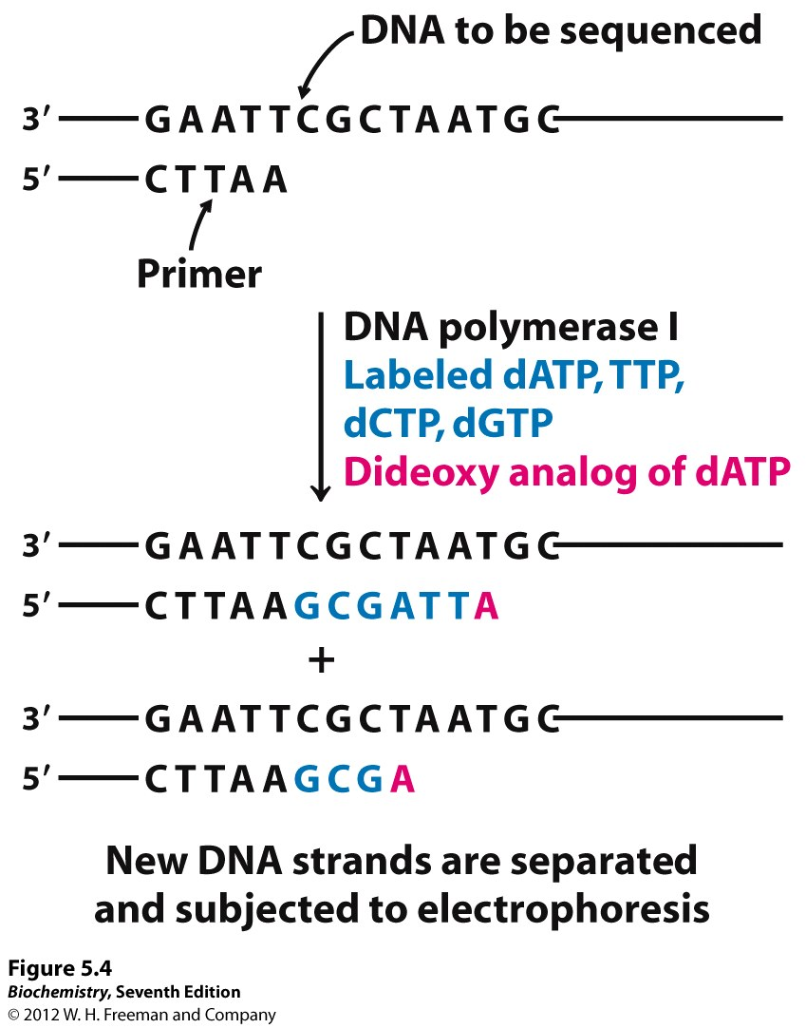

Slide 11
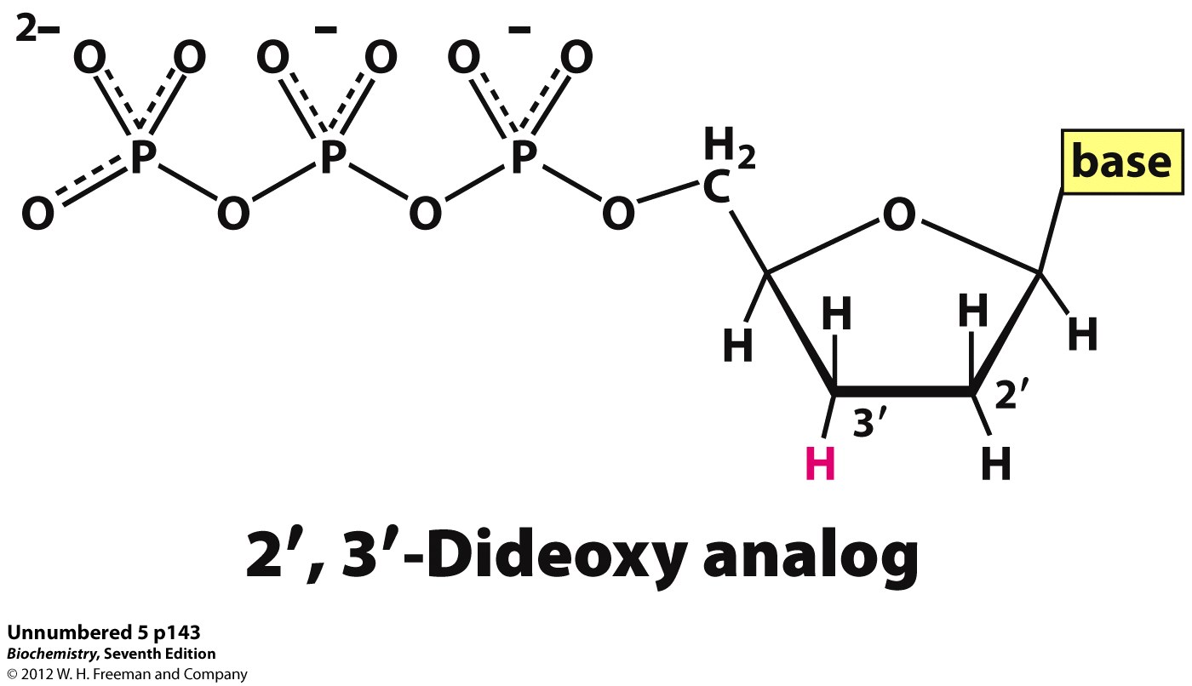

Slide 12
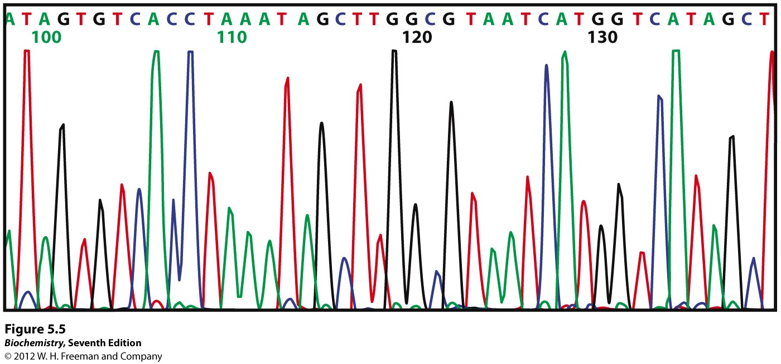

Slide 13
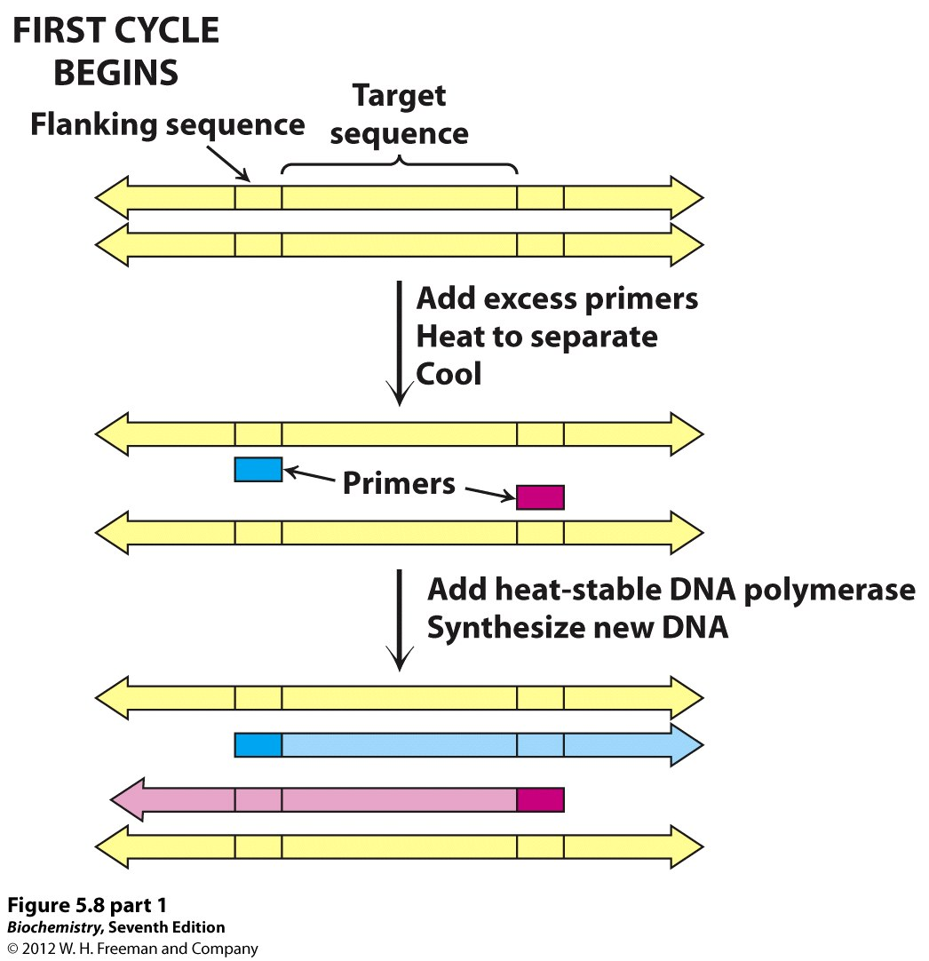

Slide 14
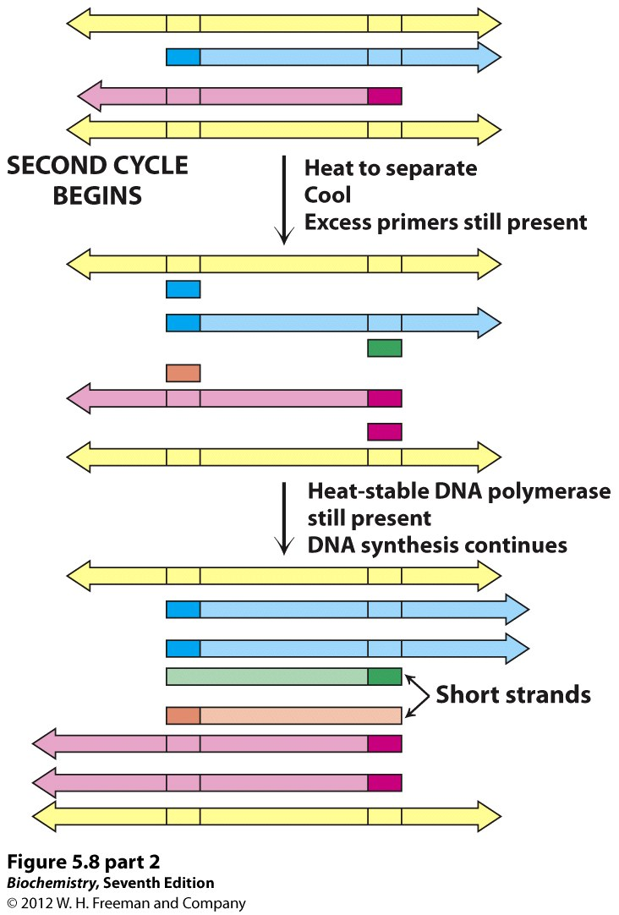

Slide 15
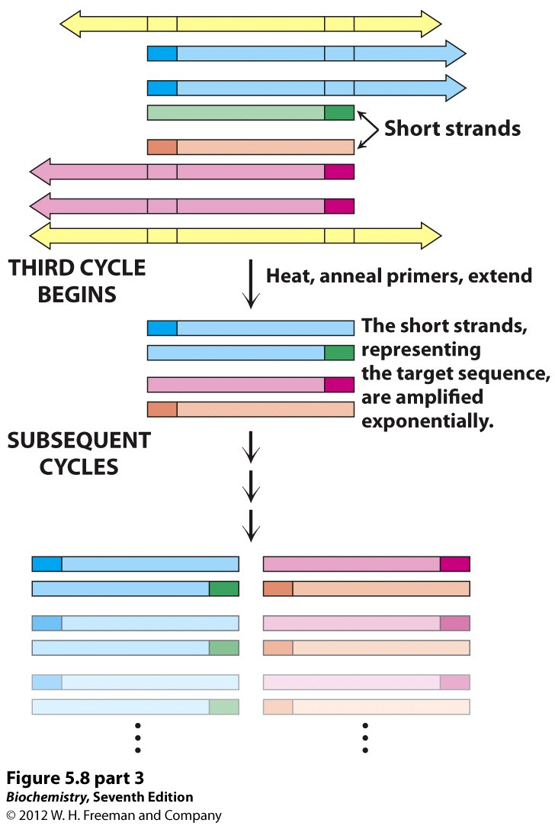

Slide 16
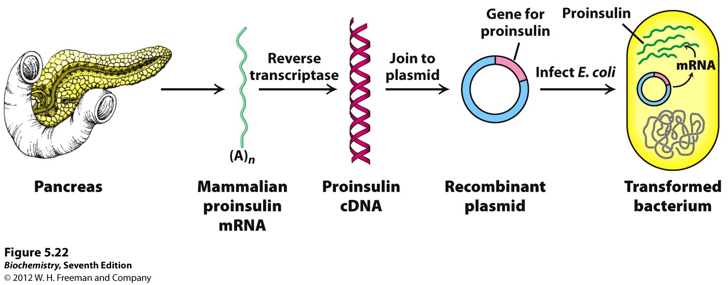
RT PCR—start with mRNA

Slide 17
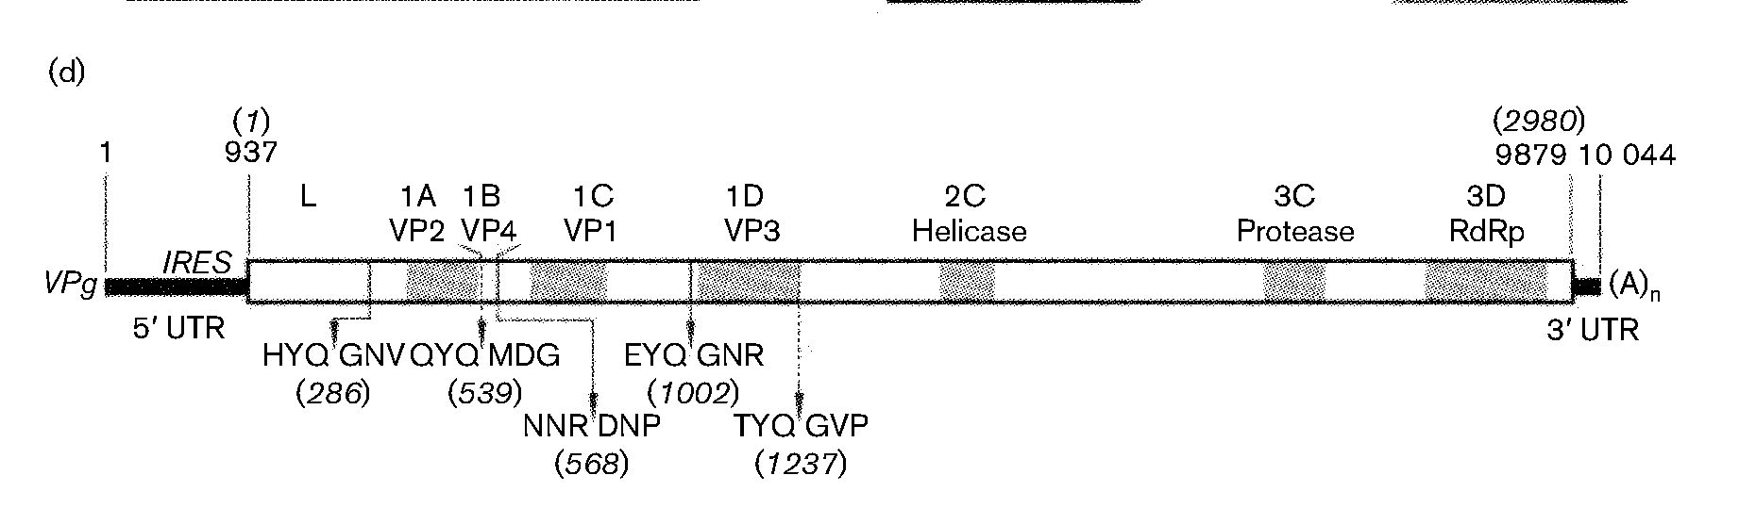
Reverse transcription (RNA→DNA)
Sequencing DNA
Comparison with known sequences identifies genes (BLAST)
+strand RNA virus
Structural and enzymatic genes
Polyprotein with protease sites
RNA dependent RNA polymerase
Enzymes visible in gel?

Slide 18
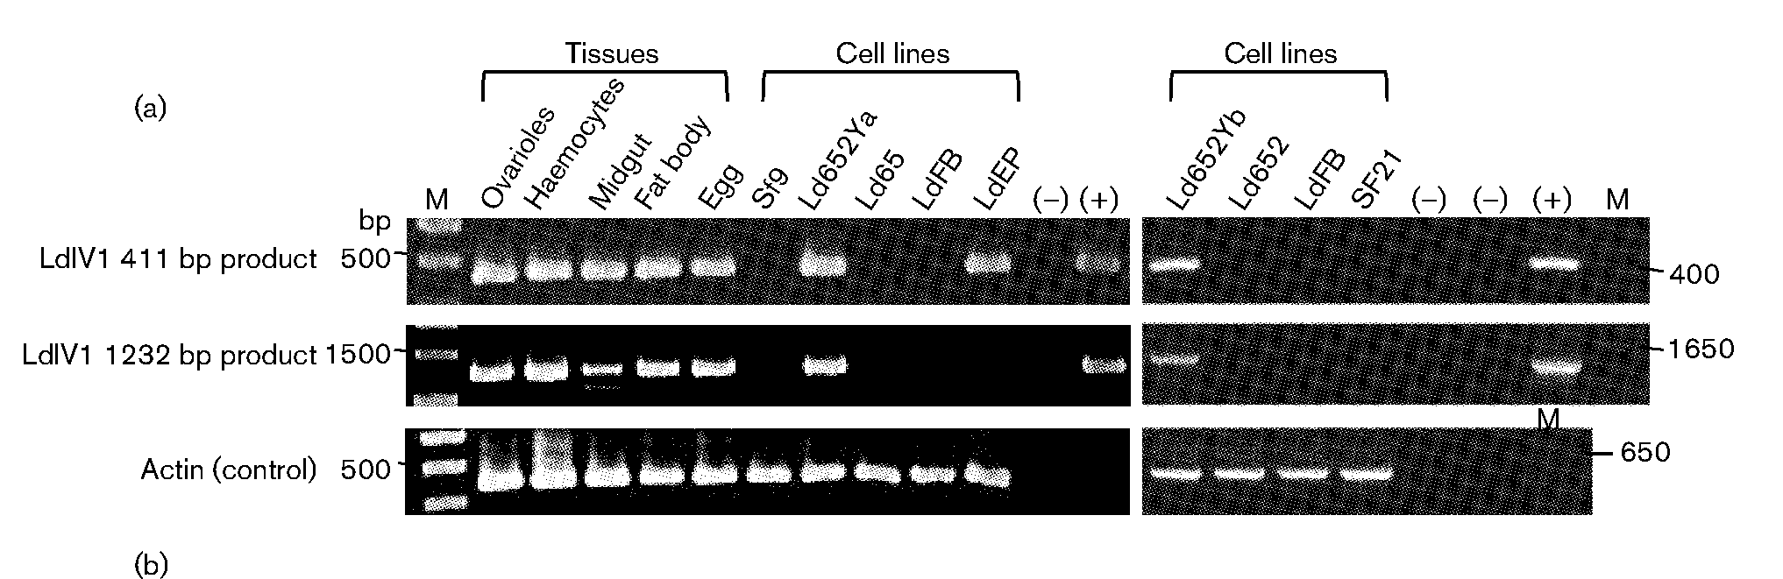
RT-PCR shows virus present in all tissues/all life stages
Agarose gels

Slide 19
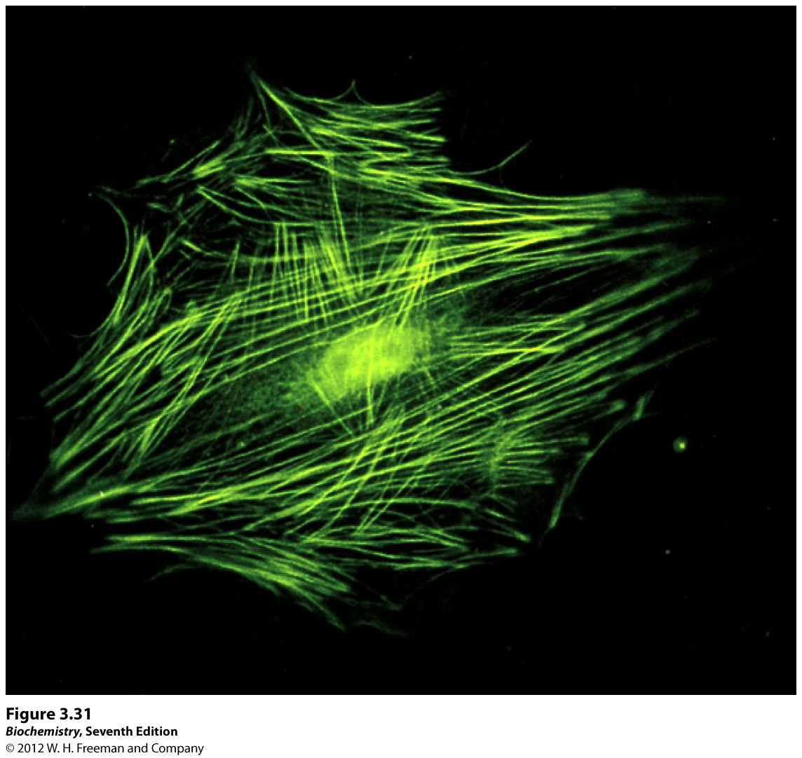
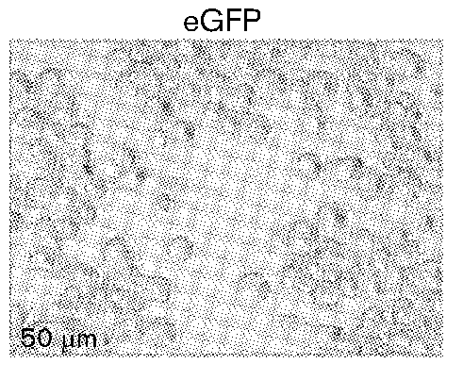
Rate of viral replication
and localization
can be monitored
using GFP

Slide 20
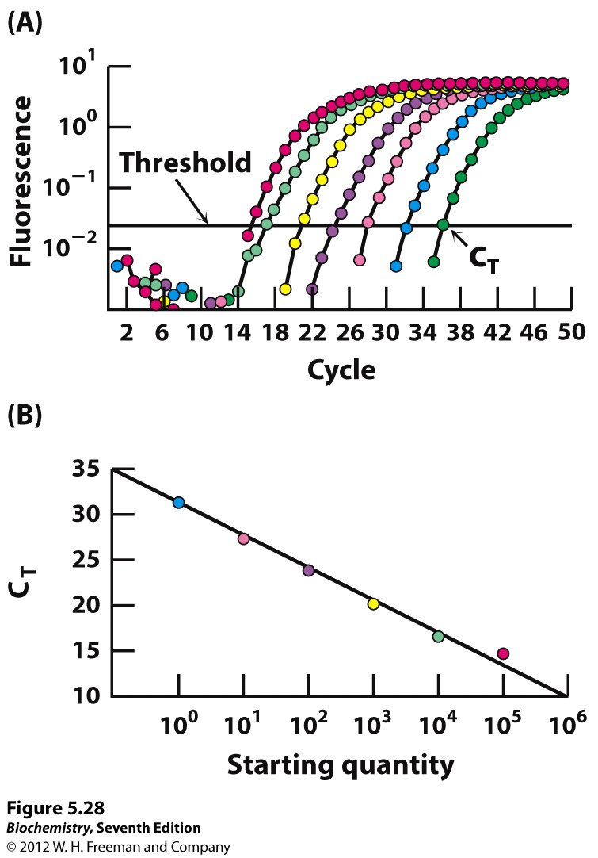
q PCR
Real time PCR
Measure [DNA] or [RNA]
Viral Loads
PCR + Sybyr Green
Viral loads are higher
When RNAi is abolished

Slide 21
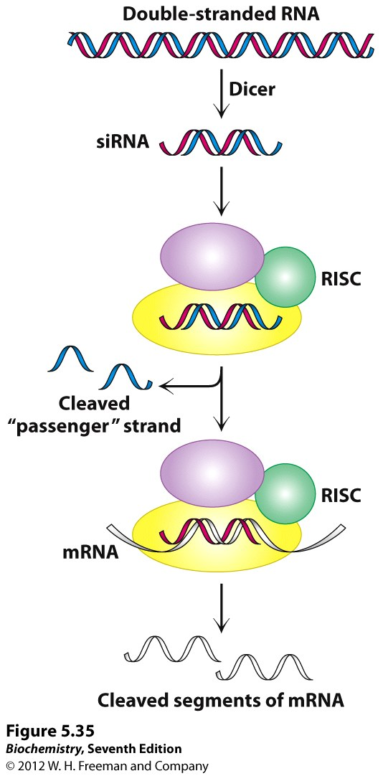
Interfering RNA
RNAi in host cells
Reduces viral load
Enables persistent, chronic infection

Slide 22
Viral gp120/host CD4 & CCR5 protein/protein interaction

Slide 23
Blocks HIV entry
ARVs
HAART
Target
reverse transcriptase
Protease
Integrase?

Slide 24
Several
Anti-Antiviral
Strategies
Li et al.
www.cell-research.com |
Cell Research,
15(11-12):923-934,
Nov-Dec 2005

Slide 25
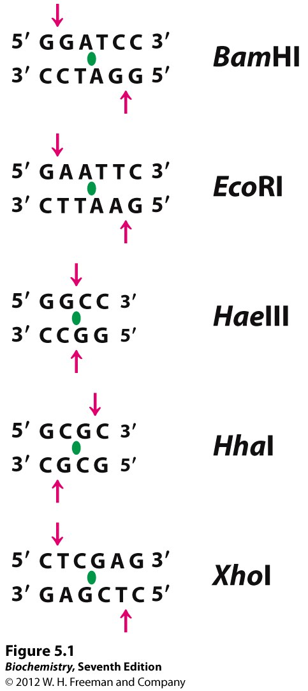
Restriction Enzymes
Bacteria’s recognize
and cleave
foreign/viral DNA
Discovery made
Cloning
DNA manipulation
Possible
(molecular biology)

Slide 26
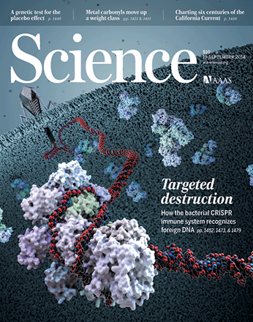
Bacterial CRISPR
Recognizes and cleaves
Foreign DNA
19 September 2014

Slide 27
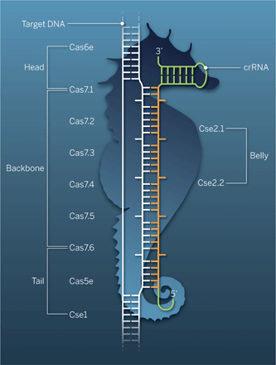
cRNA base pairs with
target DNA
Bulged bases create kinks
Cascading into focus
Yan Zhang and
Erik J. Sontheimer
Science 19 September 2014: 1452-1453.
Structures of a multisubunit protein-RNA complex reveal how the CRISPR system recognizes DNA targets

Slide 28
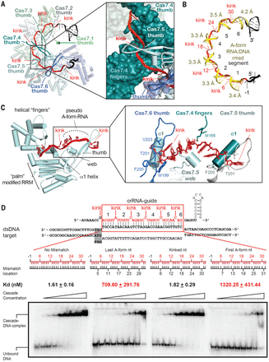
Science
19 September, 2014
Crystal structure of the CRISPR RNA–guided surveillance complex from Escherichia coli
Ryan N. Jackson
Sarah M. Golden
Paul B. G. van Erp
Joshua Carter
Edze R. Westra
Stan J. J. Brouns
John van der Oost
Thomas C. Terwilliger
Randy J. Read
Blake Wiedenheft

