Slide 1
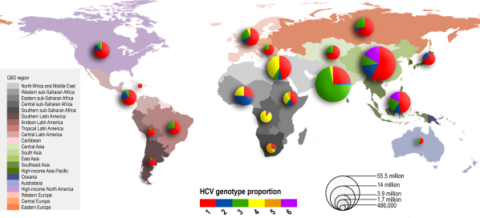
Global distribution and prevalence of hepatitis C virus genotypes
https://serendip.brynmawr.edu/oneworld/virus
>3 million US
> 100 million worldwide
blood
Hepatology Volume 61, Issue 1, pages 77-87, 28 JUL 2014 DOI: 10.1002/hep.27259 http://onlinelibrary.wiley.com/doi/10.1002/hep.27259/full#hep27259-fig-0001
Notes:
Relative prevalence of each HCV genotype by GBD region. Size of pie charts is proportional to the number of seroprevalent cases as estimated by Hanafiah et al.
© IF THIS IMAGE HAS BEEN PROVIDED BY OR IS OWNED BY A THIRD PARTY, AS INDICATED IN THE CAPTION LINE, THEN FURTHER PERMISSION MAY BE NEEDED BEFORE ANY FURTHER USE. PLEASE CONTACT WILEY'S PERMISSIONS DEPARTMENT ON PERMISSIONS@WILEY.COM OR USE THE RIGHTSLINK SERVICE BY CLICKING ON THE 'REQUEST PERMISSION' LINK ACCOMPANYING THIS ARTICLE. WILEY OR AUTHOR OWNED IMAGES MAY BE USED FOR NON-COMMERCIAL PURPOSES, SUBJECT TO PROPER CITATION OF THE ARTICLE, AUTHOR, AND PUBLISHER.

Slide 2
HCV Genome 9 kb Flavivirus +RNA single strand

Slide 3
Polyprotein→protease

Slide 4
Protein Functions

Slide 5
HCV life cycle

Slide 6
HCV—Hepatitis C
PLOS Neglected Tropical Diseases 7, #9, 2435

Slide 7
Abstract/ Conclusions
HCV patients 20/157
Median age 32 years
Fever 10
Jaundice 7
Hemorrhage 2

Slide 8
PCR Diagnosis
Target amplicon

Slide 9
HCV and Liver Function
13 patients
92% low serum albumin
77% high aspartate aminotransferase
85 % high lactate dehydrogenase
38 % high urea nitrogen

Slide 10
HCV Phylogeny N. Ghana

Slide 11
Science 13 February 2015:
Vol. 347 no. 6223 pp. 771-775
Structural basis for RNA replication by the hepatitis C virus polymerase
Todd C. Appleby1,*, Jason K. Perry1, Eisuke Murakami1, Ona Barauskas1, Joy Feng1, Aesop Cho1, David Fox III2, Diana R. Wetmore2,
Mary E. McGrath1, Adrian S. Ray1, Michael J. Sofia1, S. Swaminathan1,
Thomas E. Edwards2,*
- Author Affiliations
1Gilead Sciences, 333 Lakeside Drive, Foster City, CA 94404, USA.
2Beryllium, 7869 NE Day Road West, Bainbridge Island, WA 98110, USA.

Slide 12
Gilead—liver pipeline

Slide 13
sofosbuvir

Slide 14
Crystallography—in Ghana?
Clone,
Express,
Purify
Proteins
Lots
Of
Computer
Work

Slide 15
HCV Polymerase-RdRp-NS5B

Slide 16
Active site-2 RdRps—same structure

Slide 17
HCV-RdRp-Initiation Complex

Slide 18
Active site

Slide 19
Elongation Complex-deleted B-loop

Slide 20
Sofosbuvir—replaces substrate, but H bonds disrupted

Slide 21
Initiation to Elongation Does structure support kinetics data?

Slide 22
Tuberculosis-Science 328, 2010, 852

Slide 23
“Tuberculosis, TB, is a disease that, in the Western world, is held in check by effective public health systems that compensate for the relative shortcomings of current intervention strategies.”
“It is only through the combination of drugs, vaccines, and public health surveillance that we can hope to break the cycle of transmission whereby each TB patient is responsible for one or more new cases of the disease.”

Slide 26
Bio-markers for disease progression needed
PET Sca
18F-dGlucos
CAT Scan

Slide 27
Discovering New Antibiotics
Target TB—Mycobacterium tuberculosis
(10%)
Screen natural soil extracts for selective anti-TB activity (Staphylococcus aureus) (30%)
Lentzea kentuckyensis DQ291145 –lassomycin (2%) (selectively kills TB

Slide 28
April, 2014, Vol 21, 509-18.

Slide 29
Lassomycin Structure.

Slide 30
Lassomycin operon

Slide 31
Lassomycin activity against TB

Slide 32
Lassomycin Activity against non TB

Slide 33
Lassomycin vs exponential or stationary TB

Slide 34
Complete genome sequencing→target Lassomycin resistance mutations ClpC1 ATP dependent Protease

Slide 35
Activity/Specificity Assays

Slide 36
Docking Lassomycin , electrostatic and thermal maps (N-ter only)

