Slide 1
New pharmaceuticals
How to choose disease?
How to find drugs?
  Target-driven
  Screening
  Traditional medicine
https://serendip.brynmawr.edu/oneworld/virus

Slide 2
Pharmaceutical Pipeline
Issues—Expense—Target Diseases?
Copy cat drugs
Off-label

Slide 3
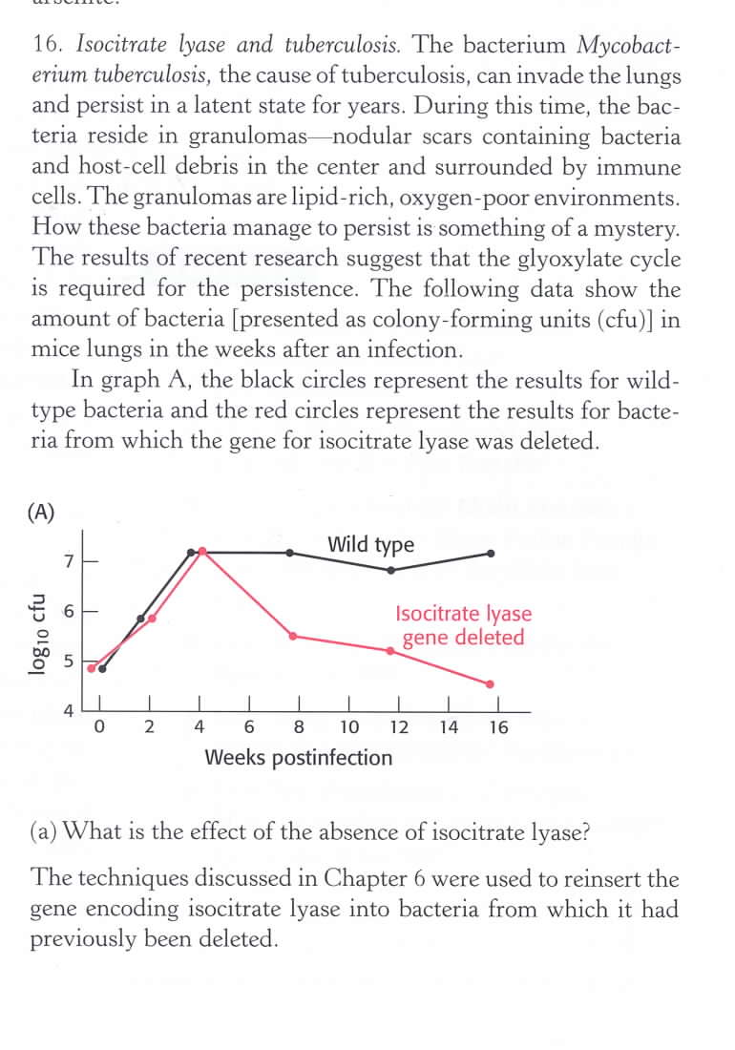
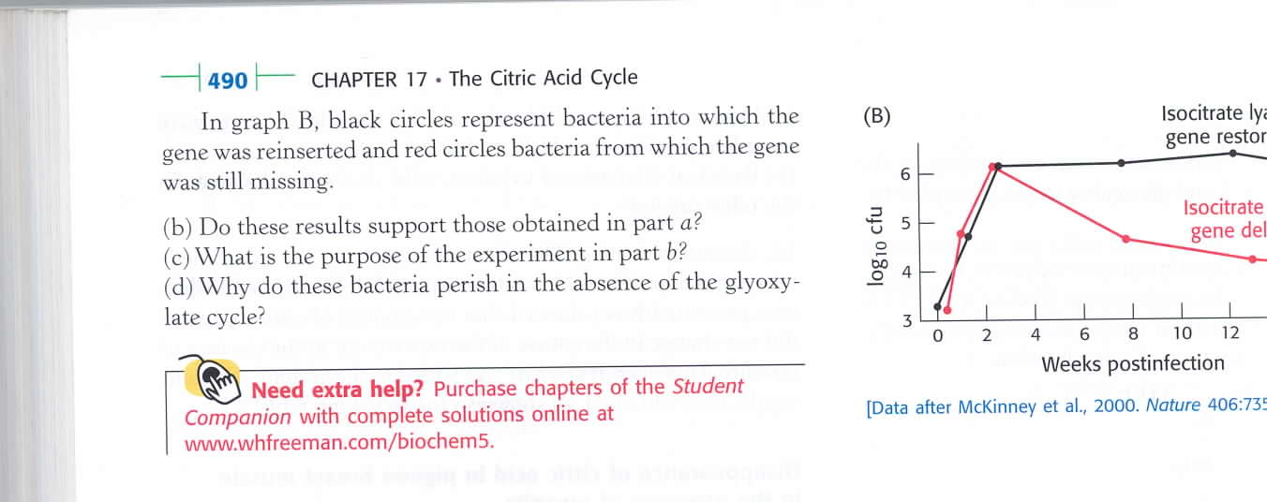

Slide 4
Modern pharmaceutical approaches--
Figure out what enzymes the pathogen uses and
go for it!
DRUG DISCOVERY
Identify pathogen
Find essential enzyme
Inhibit essential enzyme
Tuberculosis--isocitrate lyase seems to be required.
Genetic Engineering Experiments
Delete gene--few colonies
Restore gene--normal growth
Data from 2000, 2005, today

Slide 5
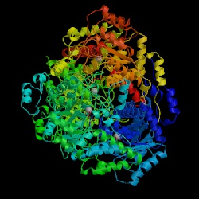
Science, Vol 289, Issue 5482, 1123-1125 , 18 August 2000
A Weak Link in TB Bacterium Is Found
Easily the most successful human pathogen in the world,
the bacterium that causes tuberculosis infects one-third
of the world's population. Often acting in deadly combination
with AIDS, TB kills 2 million to 3 million people per year,
more than any other infectious disease.
The secret of the pathogen's success is that it can linger
undetected in the lungs for decades
During its latent days inside macrophages, the bacterium is stuck with a restricted diet: It eats carbon from lipids via a pathway called the glyoxylate shunt present in bacteria and plants. The TB bacterium also builds amino acids via the oft-memorized Krebs cycle, explains McKinney, but "we went after the glyoxylate shunt because it's the only [pathway the bacteria use for metabolism] not found in humans.”
In a second publication in the August issue of Nature Structural Biology, they describe the protein structure of ICL. They also identify two compounds that smother the active end of ICL and shut down the enzyme, thus preventing it from playing its part in the glyoxylate shunt.

Slide 6
2005 Nature Medicine
M. tuberculosis isocitrate lyases 1 and 2 are jointly required for in vivo growth and virulence
Ernesto J. Muñoz-Elías1 and John D. McKinney1,*
Laboratory of Infection Biology, The Rockefeller University, New York, NY 10021
Abstract
Genes involved in fatty acid catabolism have undergone extensive duplication in the genus Mycobacterium, which includes the etiologic agents of leprosy and tuberculosis. Here, we show that prokaryotic- and eukaryotic-like isoforms of the glyoxylate cycle enzyme isocitrate lyase (ICL) are jointly required for fatty acid catabolism and virulence in Mycobacterium tuberculosis. While
deletion of icl1 or icl2 had little effect on bacterial growth in macrophages and mice, deletion of both genes resulted in complete impairment of intracellular replication and rapid elimination from the lungs. The feasibility of targeting ICL1 and ICL2 for chemical inhibition was demonstrated using a dual-specific ICL inhibitor, which blocked growth of M. tuberculosis on fatty acids and in
macrophages. The absence of ICL orthologs in mammals should facilitate the development of glyoxylate cycle inhibitors as novel drugs for the treatment of tuberculosis

Slide 7
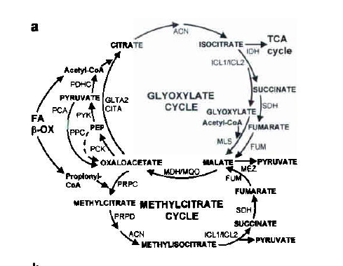
Fatty Acids, not Glucose are important fuels during infection
ICL 1 & 2

Slide 8
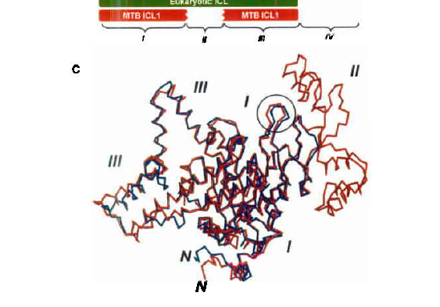
Duplicated Genes—28% identical—1 xtal structure—circled catalytic site

Slide 9
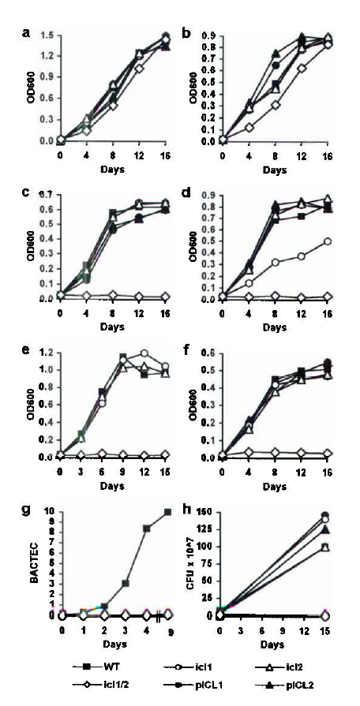
Grow bacteria in liquid media
Glycerol, glucose
Acetate, proprionate
Various fatty acids
Lipids
Wt, delete ICl1, delete ICl2, delete both
(open diamonds)

Slide 10
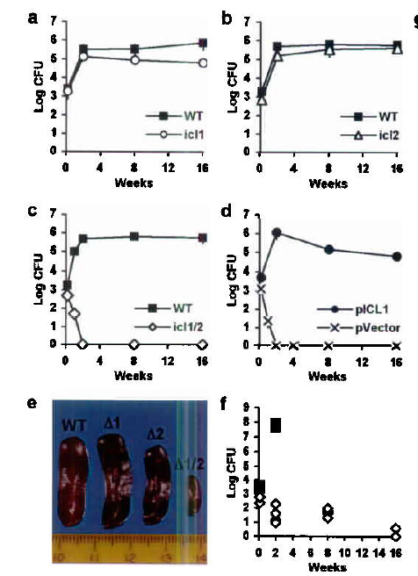
What about TB living in mouse lungs?
Infected mice have larger spleens.
(not good)
Conclude—at least one
ICL is needed for virulence
In mice.
Any drug needs to target
Both enzymes (or??)

Slide 11
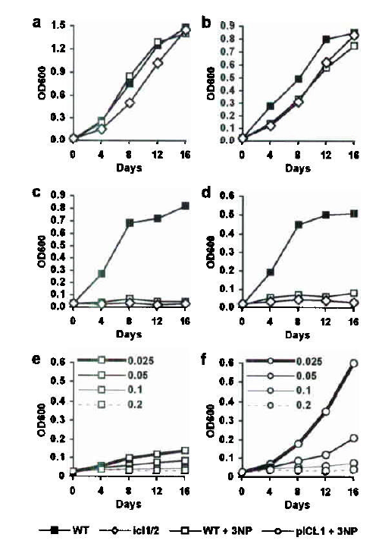

Science Works!
Science Works!
Adding the dual inhibitor NP
Is just like deleting both ICL genes.
Conclusion
Mouse
≠
What drugs are being tested?

Slide 12
Mycobacteria metabolism target

Slide 13
TB strategies
Lives in macrophages (immune cells)
  Replicates slowly
  Relies on fats, lipids, cholesterol
  250 lipid-related genes
    Many up-regulated by cholesterol
    Identify igr operon for B oxidation of cholesterol
    ChsH1 and ChsH1
Humans can’t degrade cholesterol
  Would these TB enzymes be good drug targets?
  Are they different from human enzymes?

Slide 14
Cholesterol degradation enzymes

Slide 15
Hetero tetramer (unlike other species)

Slide 16
Substrate cleft—hot dog roll

Slide 17
Large substrate→unique tetramer

Slide 18
Large substrate—small helix

Slide 19
Nature, Jan. 2015

Slide 20
iChip—helps cultivate uncultivable

Slide 21
Teixobactin from E. terrae (Gram -)

Slide 22
Kills Gram +

Slide 23
Assays

Slide 24
Teix. Targets/Binds Lipids

Slide 25
Dose-dependent Lipid I/Lipid II binding

Slide 26
Teixobactim Proposed Mechanism

Slide 27
Discovering New Antibiotics
Target TB—Mycobacterium tuberculosis
  (10%)
Screen natural soil extracts for selective anti-TB activity (Staphylococcus aureus) (30%)
Lentzea kentuckyensis DQ291145 –lassomycin (2%) (selectively kills TB

Slide 28
April, 2014, Vol 21, 509-18.

Slide 29
Lassomycin Structure.

Slide 30
Lassomycin operon

Slide 31
Lassomycin activity against TB

Slide 32
Lassomycin Activity against non TB

Slide 33
Lassomycin vs exponential or stationary TB

Slide 34
Complete genome sequencing→target
Lassomycin resistance mutations ClpC1 ATP dependent Protease

Slide 35
Activity/Specificity Assays

Slide 36
Docking Lassomycin , electrostatic and thermal maps (N-ter only)

Slide 37
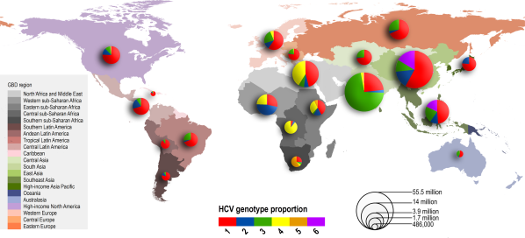
Global distribution and prevalence of hepatitis C virus genotypes
>3 million US
> 100 million worldwide
blood
Hepatology
Volume 61, Issue 1, pages 77-87, 28 JUL 2014 DOI: 10.1002/hep.27259
http://onlinelibrary.wiley.com/doi/10.1002/hep.27259/full#hep27259-fig-0001
Notes:
Relative prevalence of each HCV genotype by GBD region. Size of pie charts is proportional to the number of seroprevalent cases as estimated by Hanafiah et al.
© IF THIS IMAGE HAS BEEN PROVIDED BY OR IS OWNED BY A THIRD PARTY, AS INDICATED IN THE CAPTION LINE, THEN FURTHER PERMISSION MAY BE NEEDED BEFORE ANY FURTHER USE. PLEASE CONTACT WILEY'S PERMISSIONS DEPARTMENT ON PERMISSIONS@WILEY.COM OR USE THE RIGHTSLINK SERVICE BY CLICKING ON THE 'REQUEST PERMISSION' LINK ACCOMPANYING THIS ARTICLE. WILEY OR AUTHOR OWNED IMAGES MAY BE USED FOR NON-COMMERCIAL PURPOSES, SUBJECT TO PROPER CITATION OF THE ARTICLE, AUTHOR, AND PUBLISHER.

Slide 38
HCV Genome 9 kb
Flavivirus +RNA single strand

Slide 39
Polyprotein→protease

Slide 40
Protein Functions

Slide 41
HCV life cycle

Slide 42
Science 13 February 2015:
Vol. 347 no. 6223 pp. 771-775
Structural basis for RNA replication by the hepatitis C virus polymerase
Todd C. Appleby1,*, Jason K. Perry1, Eisuke Murakami1, Ona Barauskas1, Joy Feng1, Aesop Cho1, David Fox III2, Diana R. Wetmore2,
Mary E. McGrath1, Adrian S. Ray1, Michael J. Sofia1, S. Swaminathan1,
Thomas E. Edwards2,*
- Author Affiliations
1Gilead Sciences, 333 Lakeside Drive, Foster City, CA 94404, USA.
2Beryllium, 7869 NE Day Road West, Bainbridge Island, WA 98110, USA.

Slide 43
Gilead—liver pipeline

Slide 44
sofosbuvir

Slide 45
Crystallography—in Ghana?
Clone,
Express,
Purify
Proteins
Lots
Of
Computer
Work

Slide 46
HCV Polymerase-RdRp-NS5B

Slide 47
Active site-2 RdRps—same structure

Slide 48
HCV-RdRp-Initiation Complex

Slide 49
Active site

Slide 50
Elongation Complex-deleted B-loop

Slide 51
Sofosbuvir—replaces substrate, but H bonds disrupted

Slide 52
Initiation to Elongation
Does structure support kinetics data?

