Slide 1
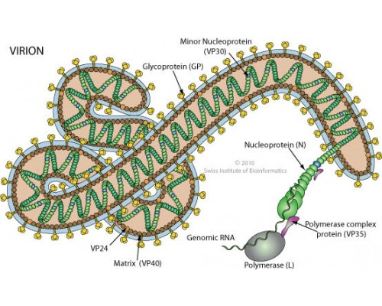
From Swiss Inst of Bioinformatics
https://serendip.brynmawr.edu/oneworld/virus
EBOLA VIRUS

Slide 2
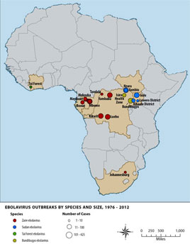
Ebola Virus Discovery
1976
Inject in mice
Electron microscopy

Slide 3
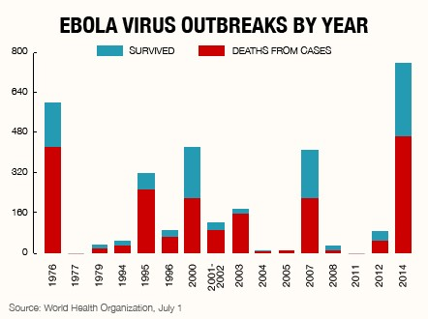

Slide 4
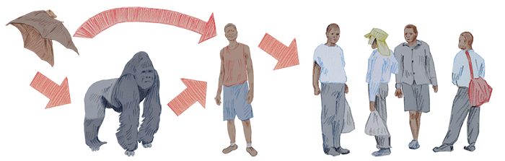
Transmission of EBOV
(and search for reservoir species)
Susceptible to EBOV
Gorilla
Chimpanzee
Duiker
(laboratory mice)
Some infections occur
Following bat sightings.
Related viruses have bat reservoirs
Experiments have failed to
reproducibly infect a wide variety
of putative reservoir species with EBOV
Microbes and Infection, 2005,
The Natural History of Ebola Virus in Africa

Slide 5
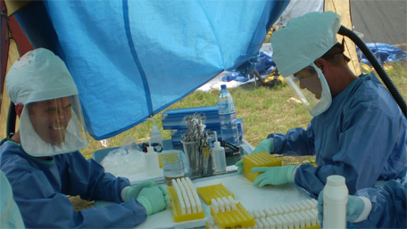

Slide 6
Ghana 2008-2011 Survey
Methodology—surveyed fever patients Central/North Ghana—18 hospitals/285 patients
  PCR to amplify EBOV L gene
  ELISA (hepatitis)
  Sequencing
No Ebola
Major illness Hepatitis B & C (adults), A (kids)

Slide 7
NE J. Med.
4/27/14
TEM
Contact tracing

Slide 8
Diagnosis –PCR
RT-PCR to find high viral loads
Genome sequencing
Viral Growth cell culture/FL-anti Ebola Ab
EM
phylogeny

Slide 10
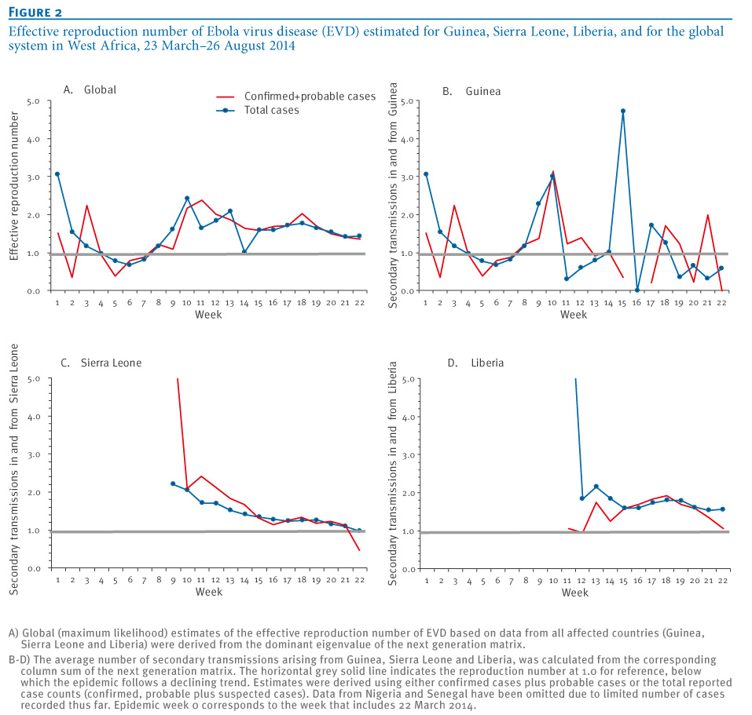
Eurosurveillance, Volume 19, Issue 36, 11 September 2014
Rapid communications
Early transmission dynamics of Ebola virus disease (EVD), West Africa, March to August 2014 H Nishiura , G Chowell
Math modelling
Transmission Rates
Rt need to be
<1 to control epidemic
Rt= number of people
Infected by each patient

Slide 11
Science Express, 28 Aug. 2014

Slide 13
Pathogenesis of Ebola-
Hartman et al, CDC
Filoviruses→Hemorraghic fever/vascular dyfunction
  Ebola (Zaire & Sudan)
  Marburg
  Reston & Ivory Coast (animals)
4-10 day incubation period; 50-90% fatal
Non-specific initial symptoms (fever, pains, nausea)
Virus and antibodies detectable with symptoms

Slide 14
Ebola pathogenesis
Coagulation connection—TF (tissue factor) levels increased→ Ebola macrophages engulfed in fibrin but Protein C level decreased (decreases coagulation)
Animal fatality reduced by anti-coagulation factor
Endothelial leakage→shock, hemorrhage Glycoprotein GP1, GP2 connection not clear

Slide 15
Ebola pathogeneis
Fatal patients—bleeding, coagulation defects, high viral levels many organs, low antibody levels
Transmission body fluids, not aerosol
Entry—mucous tissue, cuts, common receptor, replicate many cell types
Immunosuppression—enters dendritic (immature immune) cells→lymph system.
Dendritic cells coordinate innate/adaptive immune response—cytokine signalling (VP35), T-cells, interferon
Lymphocyte apoptosis

Slide 16
Ebola Goals
History and Geography
Pathogenesis
Biochemistry & Molecular Biology (and limitations & unknowns)
  Nucleic Acids
  7 Proteins
  Implications for understanding biology
  Therapeutic implications

Slide 17
Annual Rev Genetics, 1998, Conzelman

Slide 18
Replication/Transcription

Slide 20
“universal” procedure for RT-PCR
Extract RNA from 140 uL serum
20 min reverse transcriptase 50°C
95°C 5 min
10 “precycles” 95°C 5 s, 60-55°C 5s, 72°C 25 sec
40 cycles 95°C (denature), 56°C 10 s (anneal), 72°C 10 s (elongate)
$$$ equipment/hours
Under development—10 min test for “field”

Slide 21
Advertising e-mail arrived Aug. 8, 2014

Slide 22
Comprehensive Functional Analysis of N-Linked Glycans on Ebola Virus GP1—Lenneman et al MBIO Aug. 1, 2014
Endosome proteolytic processing

Slide 23
Why study GP1/GP2?
Viral entry—RBD=receptor binding site
Vaccine development
Understand role of conserved glycosylation—
Mutate conserved N, Y so GP1 will be expressed –sugar
  Pseudovirus in tissue culture
Results
  Sugar removal allows protein production, increases viral entry (including macrophages), cell binding, protease susceptibility, cathespin B independence, but decreases binding NPC1 receptor
  Ca ²⁺ binds receptor lectins that bind glycans has some reduced binding when glycosylation is removed
  Near complete sugar removal allows greater anti-sera recognition for GP1 core only
Authors suggest GLYCAN SHIELD more important than entry reduction as reason evolutionary conservation.

Slide 24
Ebola Vaccine Development
Want anti-GP antibodies (acute infection)
Want longer term protection (CD8/T cell/cytokine)
Adenovirus can deliver GP, but many are immune to human vectors→Chimp adenovirus
Use non-replicating form of virus
Booster with MVA protects 100% Macaques

Slide 25
Nature Medicine, 7 Sept. 2014

Slide 26
10 month challenge with lethal Ebola Dose

Slide 27
Ebola Polymerase L
associates with
Topoisomerase I

Slide 28
Topoisomerase I
Known to be important in viral replication/transcription
Strand breaking is important
Inhibition of Top I results in less Ebola replication
Ebola changes localization of TopI
Therapeutic implications??
J. Virology Aug. 2013, Takahashi et al

Slide 29
L gene—RdRp
RNA dependent RNA polymerase
2000 amino acids
Two domains
  Polymerase
  Transcription factor
Template is RNP
Humans don’t have this enzyme
Good therapeutic target
Like HIV RT???
Why so little research?

Slide 30
Co-factor

Slide 31
Potential PPIs for VP35
(based on VP35 biochemistry/structure)

Slide 32
NMR—solution experiment
Verifies that drugs bind.
Perturbs chemical shift.
Binding pocket mutants have
no chemical shift change

Slide 33
Do drugs disrupt NP/VP35-IID interaction? Stop polymerase?
Pull down assay with
amylose beads.
If VP35/IID binds NP,
an NP-His band is visible.
2 drugs inhibit binding
Ebola polymerase complex
Includes
EBOV L, VP30, VP35, NP
Several drugs show dose
Dependent inhibition

Slide 34
Do drugs stop virus?
Some drugs reduce viral
infectivity
and
viral release

Slide 35
Ebola Virus Modulates Transforming Growth Factor Signaling and
Cellular Markers of Mesenchyme-Like Transition in Hepatocytes
Proteomics/Kinomics Approach
How does EBOV affect global signalling?
  How are phosphorylation patterns changed?
  Therapeutic targets?
Kindrachuk et al J. Virology September, 2014

Slide 36
Kinome Array
300 peptide targets in array expose to active kinases in lysate
P1
P300
PEPTIDE TARGET + cognate kinase→ PEPTIDE TARGET—P
Pattern of target phosphorylation→ kinase ID
What pathways are activated 1 hr, 6 hr, 24 hr?

Slide 37
Results
TGF-β pathway up-regulated (secretion TGF-β and VEGF confirmed by ELISA)
Use inhibitors of pathway TGF-β, P13K/AKT, MAPK/EFK, raf, JNK, PKC
Early use of some inhibitors
Reduced mouse fatalities

Slide 38
EMT (epithelial to mesenchyme transition)
TGF-β normal roles—wound healing, cell growth/differentiation, migration, immune response
What is happening to EBOV-infected cells?
Epithelial tissues first infected—adherens/tight junctions disassembled. Gene expression pattern changes to reduce epithelial and increase mesenchyme cytoskeletal expression

Slide 39
Western blots/phosphorylation
EMT protein TGF-β pathway P antibodies
Article error—figure legend switched 8&9

Slide 40
EMT—local plus systemic effects

Slide 41
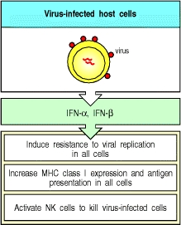

Slide 42
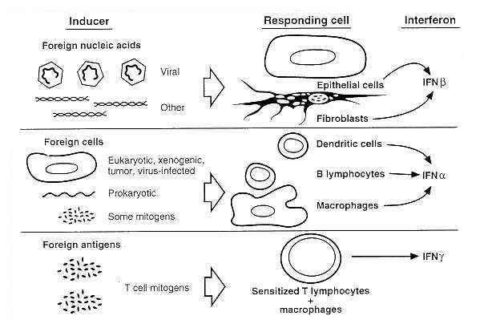
From Medical Microbiology 4th ed edited by Baron (1996)

Slide 43
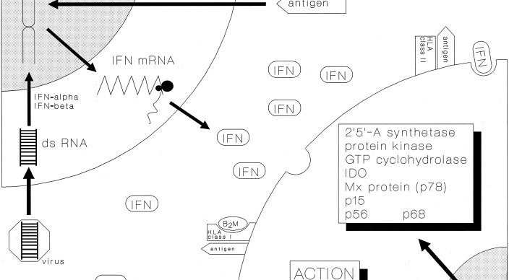
Interferon protects uninfected cells by changing gene expression

Slide 44
Ebola Virus VP24 Targets a Unique NLS Binding Site on Karyopherin Alpha 5 to Selectively Compete with Nuclear Import of Phosphorylated STAT1 Xu et al Cell Host & Microbe, 2014

Slide 45
Proposed Model
STAT1 must enter nucleus for interferon response
STAT1 binds to KPNA for nuclear transport
eVP24 binds strongly to KPNA
eVP24 competes with STAT1 for same KPNA binding site
eVP24 and STAT1 binding sites overlap and are distinct from binding sites for normal transported molecules
eVP24 prevents normal interferon response by blocking STAT1 transport to nucleus, but does allow entry other molecules

Slide 46
Evidence for model
Crystallography structure—
shows hydrophobic and H-bonding
at interface→ very strong binding
eVP24/KPNA
KPNA can be severely truncated
and still bind eVP24

Slide 47
More evidence for model
Immunoprecipitation using anti-FLAG antibodies
To pull down eVP24 plus “normal” cargo or STAT1
WT eVP24 prevents STAT1 but not DMC1 from binding

Slide 48
Last evidence for model
Assay tests
whether interferon
can induce promoter
WT eVP24 reduces
Expression by >90%
Marburg Virus mVP24
has different sequence
in key positions and
does not block STAT1
nuclear entry or interferon
response.

