Slide 1

The Psychology of Disability and Mental Health
Tyler Kinkema

Slide 2

mental health among people with disabilities
STATISTICS
WHY THIS OCCURS?
People with disabilities are 5 times more likely to experience consistent mental distress (CDC)
People with disabilities are more likely to be diagnosed with depression and anxiety
  Social isolation and stigma
  Environmental barriers
  Pain and fatigue
  Discrimination
  Unemployment
  Poverty
  Medications
  Lack of healthcare access
  Neurological side effect of disability

Slide 3

How to address this problem
Current Solutions
The Gap
  Address environmental factors
  Help people feel connected and included in their community
  Increase healthcare access
  These solutions focus on structural and environmental factors
  I want to focus on improving the healthcare experience itself
    Even with better housing, jobs, and access, mental distress will persist if the healthcare system itself reinforces stress, misunderstanding, and disempowerment

Slide 4

How the Healthcare System Contributes to the Problem
  Long time to diagnosis
  People with disabilities spend a lot of time in the medical system
  Healthcare system set up as a specialized industry with targeted care
    Rarely looks at you holistically
    Separation between psychology and medical system

Slide 5
The Cycle of Mental Distress and Disability
Disability symptoms
Unable to meet social expectations
Increased stress
Decreased mental health
Increased disability symptoms
Less able to meet social expectations
Greater stress
  As the nervous system regulation and physical health are so intertwined, a decrease or increase in either will affect the other
    Some disabilities are uniquely caused or influenced by psychological factors
Could breaking this cycle reduce mental distress?

Slide 6

MY STORY
Coach asking for constant updates
Withdrew from team trip: teammates ask when I'm coming back
Functional medicine for SIBO
Osteopathic manipulative medicine visits for neck pain
Occupational therapy visit
Assessed by trainer: confirmed signs of severe TBI
Primary care doctor: MRI normal; recovery in 2 to 4 weeks
Dropped a class (extra credits available so no consequences)
Starting to feel better; scared to do too much and set back progress
Visit to concussion specialist
Months of recovery still to go
Diagnosed with SIBO
January
March
April
Hit my head
Physical therapy: told to walk
New symptoms emerge
Interviews for summer jobs I might not be able to do
Cumulative test for class on a book without an audio version
Eye therapy
Told by trainer to "act normal" and watch my team play squash
Two-week break from classes (anymore and I would be removed for semester)
Friends asking when I'll be back, telling me I look fine
Friends asking me why I'm not going out with them
Visit to neuro-optometry; issues with divergence, convergence, and refocusing

Slide 7
What I LEARNT
Medical appointments
Social pressure from friends
Strict rules from college
15+ doctor appointments
10 different types of doctors
3 months waiting time
Extreme range of estimated recovery time:
1 week to 1 year
"Do you just have a constant headache"
"When will you be better"
"Please go out with us tonight"
"You don't look anything is wrong, you look fine"
"Any updates"
Very concerned with class credits
No short-term medical leave allowed
Few accommodations offered
The medical system doesn’t just affect treatment of disabilities - it affects everyday life

Slide 8

How THE gap BETWEEN MEDICINE AND PSYCHOLOGY shows up in care
  Medical forms
  Communication
  Impersonal treatment
  Therapy as the only recommendation for mental health concerns
  Little involvement of patient in treatment- no tasks given to patient

Slide 9
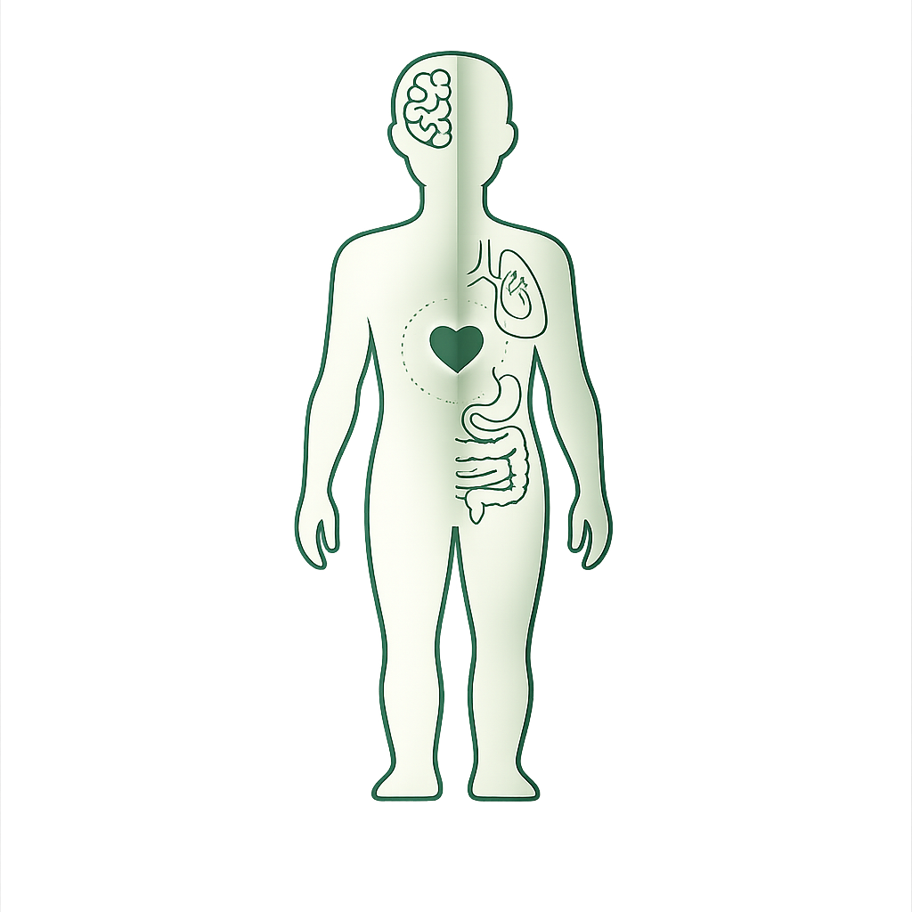
Small PRACTICAL WAYS WE CAN BRIDGE THE GAP
  1. Patient handouts for general health and specific conditions
  No increase in time burden on doctors
  2. Combined healthcare website where current/past patients can support each other and share insights
  Disability wisdom
  3. Doctor training on communication and role of psychological factors

Slide 10
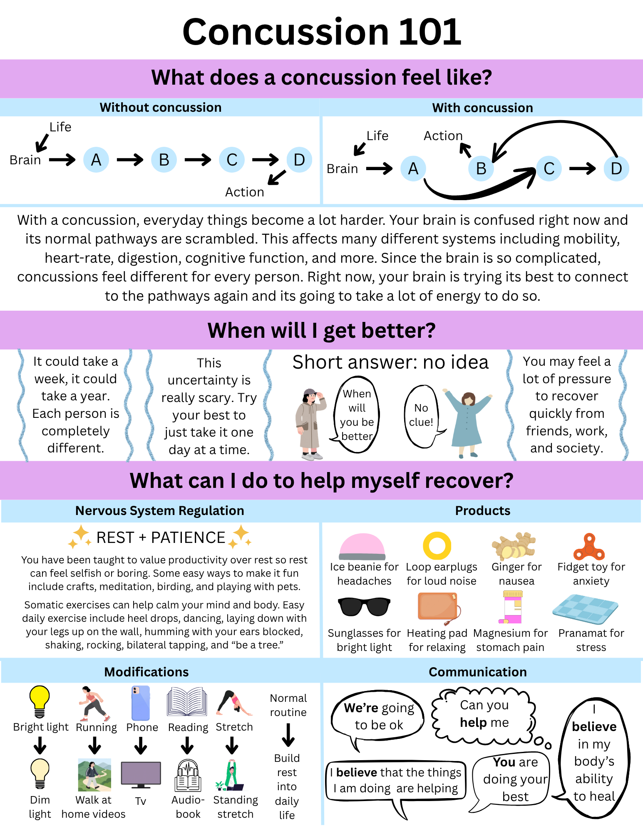
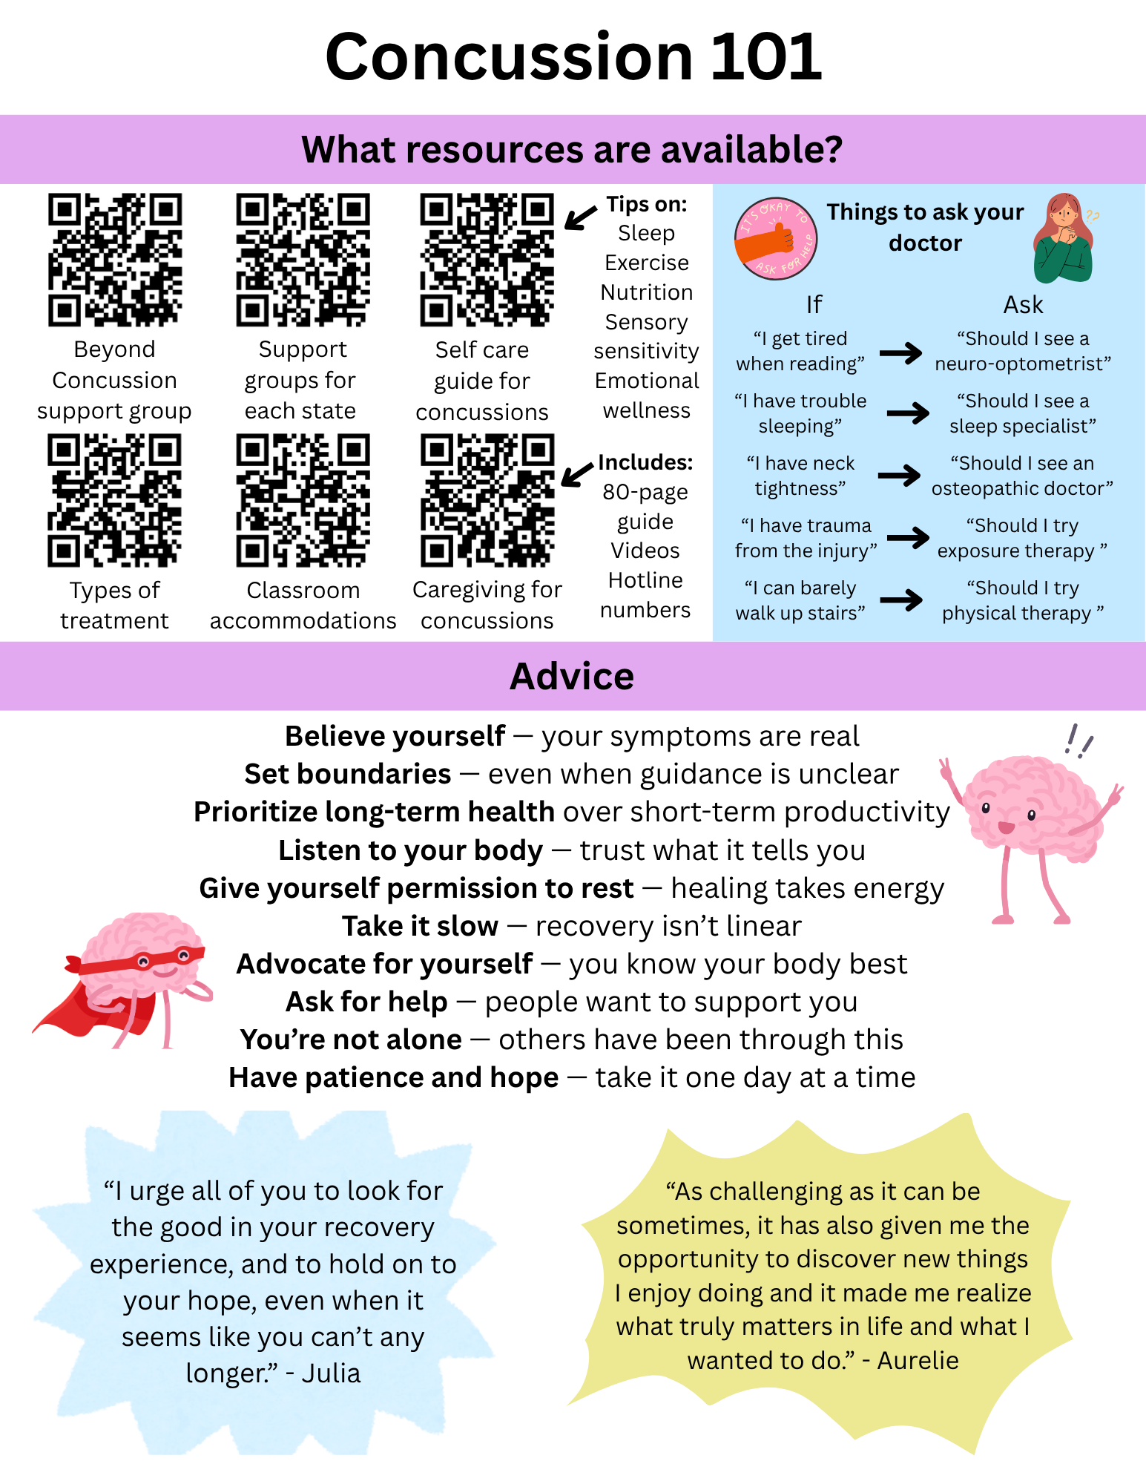

Slide 11
Impact OF THESE CHANGES
  Patient empowerment
  Better outcomes
    → fewer visits → less stress
  Places responsibility on medical system
      Other systems like workplaces and schools will follow
  Disrupts the cycle
Disability symptoms
Unable to meet social expectations
Increased stress
Decreased mental health
Increased disability symptoms
Less able to meet social expectations
Greater stress

Slide 12
Summary
Separating disability and
psychology overlooks the
impact of a holistic approach
This normalized separation reinforces a broader disconnect, allowing other systems like workplaces, schools, and public places to minimize their role
Because the medical system is seen as the authority, it has a critical role in recognizing the mind–body connection, integrating psychological approaches, and extending that understanding beyond healthcare
That’s why even small changes in how we approach care can have a much bigger impact on people with disabilities than we think

Slide 13
References
American Psychological Association (APA). How long will it take for treatment to work? 2017. https://www.apa.org/ptsd-guideline/patients-and-families/length-treatment. Accessed April 19, 2026.
Centers for Disease Control and Prevention (CDC). Many adults with disabilities report frequent mental distress. April 8, 2025. https://www.cdc.gov/disability-and-health/articles-documents/adults-with-disabilities-mental-distress.html. Accessed April 19, 2026
Clare E. Brilliant Imperfectionism: Grappling with Cure. Hypatia Reviews Online. 2019;E17.
Lorig K et al. Chronic Disease Self-Management Program. 2-Year Health Status and Health Care Utilization Outcomes. Medical Care 2001;39(11):1217-1223.

